Slide 1
What’s behind the Great Resignation?
Jasmine Leblond-Chartrand
2021-10-15

Slide 2
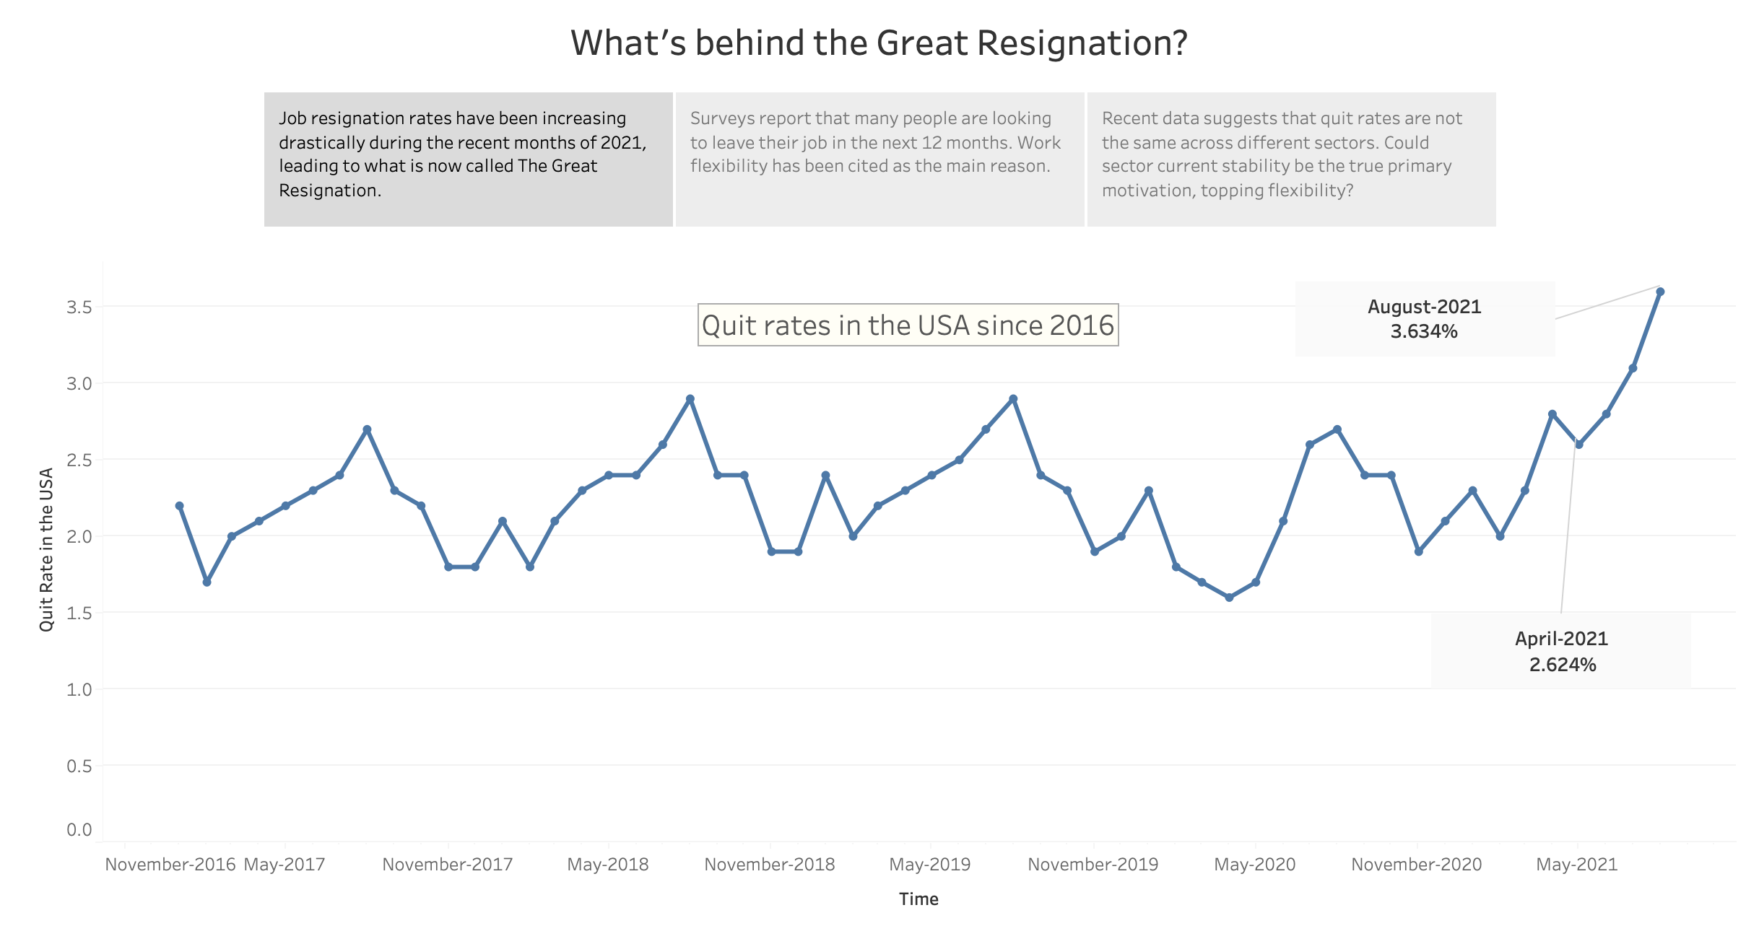


Slide 3
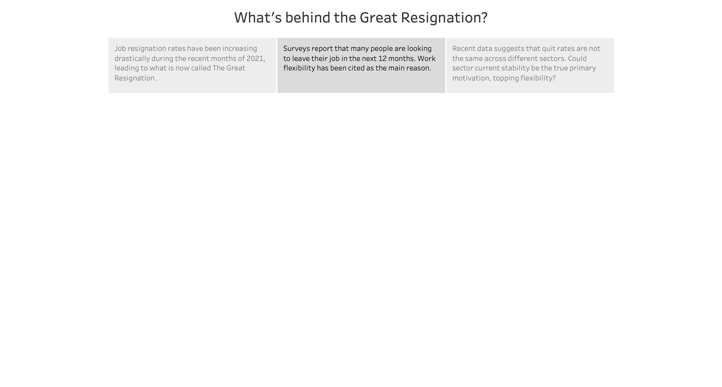
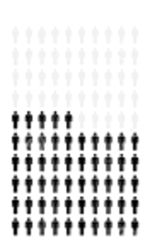
55%
of Americans anticipate looking for a new job
56%
of those surveyed said that flexibility was their primary reason to look for a new job

Slide 4
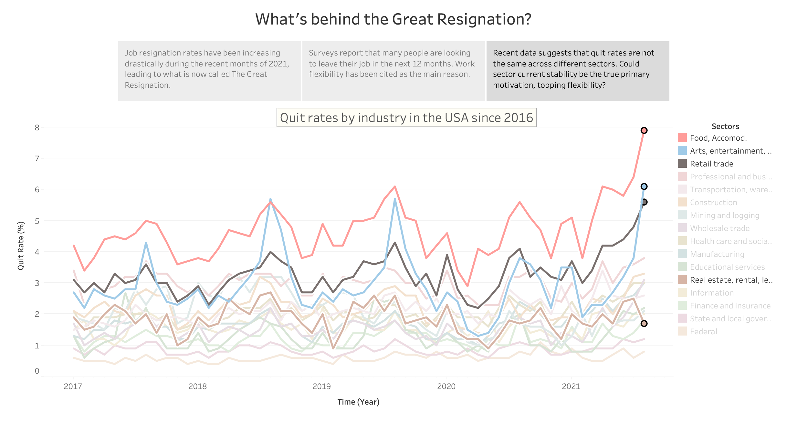

Slide 5
Sources
Levin, K. (n.d.). Fifty five percent people chart graphic, 55 percentage vector diagram [Image]. https://www.dreamstime.com/fifty-five-percent-people-chart-graphic-percentage-vector-diagram-icon-design-web-ui-flat-illustration-black-grey-white-image191271257
Morris, C. (2021, September 1). The Great Resignation Could See Half the Nation’s Workers Changing Jobs. Nasdaq. Retrieved October 15, 2021, from https://www.nasdaq.com/articles/the-great-resignation-could-see-half-the-nations-workers-changing-jobs-2021-09-01
Reinicke, C. (2021, August 25). The “Great Resignation” is likely to continue, as 55% of Americans anticipate looking for a new job. CNBC. https://www.cnbc.com/2021/08/25/great-resignation-55-percent-are-looking-to-change-jobs-over-the-next-year-.html
U.S. BUREAU OF LABOR STATISTICS. (n.d.). Employment Databases, Tables & Calculators. Retrieved October 15, 2021, from https://www.bls.gov/data/#employment

